Slide 1
The Seduction of Success
Ch.4 Counterfeit Gods
2024-02-06

Slide 2
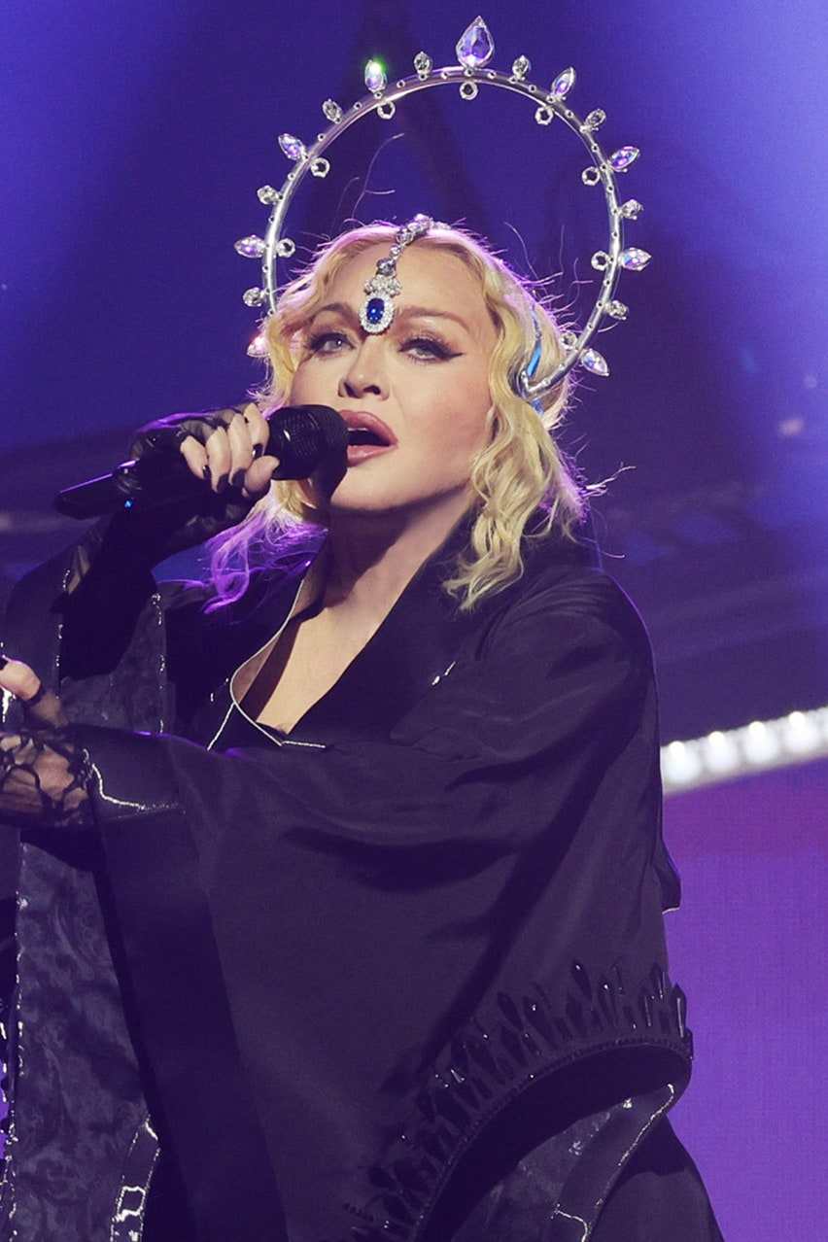
Achievement is the Alcohol of Our Time
“I have an iron will, and all of my will has always been to conquer some horrible feeling of inadequacy. My drive in life is from this horrible fear of being mediocre. Even though I’ve become somebody, I still have to prove that I’m somebody.” - Madonna →
Director Sydney Pollack “couldn’t justify his existence if he stopped” the grueling process of filmmaking even though it was wearing him down and he was unwell.
“Every time I finish a picture, I feel like I’ve done what I’m supposed to do in the sense that I’ve earned my stay for another year or so.”

Slide 3
Achievement Addiction becomes Self-abuse
You are successful
Good things happen
You feel amazing, “high level”, but it doesn’t last forever
Suppose you are rejected
Your self-esteem collapses because you’ve been gathering your self-worth externally
Eventually, you drop to the “pain level” more and more often
You become desperate about clinching the next opportunity
- Mary Bell, High-level executives’ counselor

Slide 4
Illusion of Achievement
Achievement cannot answer the questions,
Who am I?
What am I really worth?
How do I face death?
The initial rush of happiness leads us to believe that we have arrived, been included, been accepted, and proved ourselves.
However, the satisfaction quickly fades.

Slide 5
The Idolatry of Success
“We ourselves are god. Our security and value rest in our own wisdom, strength, and performance. To be at the top of the heap means we are supreme.”
Q1. Is there a sense of (false) security due to your personal success?
Do you expect nasty, brutal life? Or are you shocked and overwhelmed by troubles? Do you accept tragedy, or is “life not supposed to be this way”?
The false sense of security is rooted in the deification of our achievement and expecting it to keep us safe from the troubles of life in a way only God can.

Slide 6
The Idolatry of Success
Q2. Do you possess an inflated view of your abilities?
i.e., Do you believe that you have expertise in all areas? When achievements serve as the basis for your worth as a person, the sense of worth generalizes to broader domains.
The distorted view of ourselves is the blindness to reality that accompanies idolatry.
[15] The idols of the nations are silver and gold, made by human hands. [16] They have mouths, but cannot speak, eyes, but cannot see. [17] They have ears, but cannot hear, nor is there breath in their mouths. [18] Those who make them will be like them, and so will all who trust in them.

Slide 7
The Idolatry of Success
Q3. Do you find that you cannot maintain your self-confidence in life unless you remain at the top of your chosen field?
“I had no idea who I was, or what I could be away from tennis. I was depressed and afraid because so much of my life had been defined by my being a tennis champion. I needed the wins, the applause, in order to have an identity.” (Chris Evert)
“My life was built on two premises. The first that I could control your opinion and approval of me through my performance. The second was that that was all that mattered in life.”

Slide 8
A Culture of Competition
What job helps people flourish? V.S. What job will help me flourish?
Traditional culture measured worth by honor; those who fulfill their assigned role in the community, whether it be citizen, father, mother, teacher, ruler, are given honor.
Contemporary culture bases worth on dignity. Dignity is the right of every individual to develop his or her own identity and self – free from any socially assigned role or category.
This puts great pressure on individuals to prove their worth through personal achievement.
Students are cramming into fields of medicine, law, and finance because of the high salaries and aura of success. Students choose their profession with little reference to their meaning and purpose.
As a result, a high degree of frustration is expressed over unfulfilling work.

Slide 9
The Successful Dead Man
Naaman (2 Kings 5)
Commander of the army of Aram (Syria)
Prime minister of the nation
Wealthy man and a valiant soldier
Highly decorated and honored
But he had leprosy. His body would puff up, his skin and bones would crack, then they would fall off in stages as he died.
“Until you conquer the fear of being an outsider, an outsider you will remain” (C.S. Lewis)

Slide 10
Success isn’t the Path towards Social Acceptance.
Many people chase success as a way to overcome the sense that they are somehow outsiders.
Finally, they will be accepted by all the people who really matter.
Success promises to do that, but in the end it cannot deliver.
All Naaman’s successes were useless, since it could not overcome his alienation and despair
Naaman expected to get his cure through letters of recommendation. However, the slave girl had told Naaman to simply “see the prophet in Israel”, to go directly to the prophet and ask for a cure.
The God of Israel is not on a leash, he cannot be bought or appeased.

Slide 11
Go Wash in the Jordan Seven Times
But Naaman went away angry and said, “I thought that he would surely come out to me and stand and call on the name of the LORD his God, wave his hand over the spot and cure me of my leprosy.” (2 Kings 5:10-13)
Naaman expected Elisha to demand some great thing to earn his healing. Instead, he was asked to simply go and dip himself seven times in the Jordan River.
Naaman’s rage displays how his entire world view was being challenged. God only operates on the basis of grace. No one can control the true God because no one can earn, merit, or achieve their own blessing and salvation. Even Naaman’s success were dependent on the talents, abilities, and opportunities that God had given to him.

Slide 12
The Little Suffering Servant
The Principle: All forgiveness is costly. A price is paid for everything.
At best the servant girl’s family was taken captive and all sold off. She’s a racial outsider, a slave, a woman, and a young person whose life has been ruined utterly.
And Naaman is the one responsible for her suffering.
If the servant girl had set her heart on getting to the top, but instead found herself on the bottom, she would have been full of great cynicism and bitterness. She could have made Naaman pay for what he did to her.
But she did not seek revenge, she trusted God to be the judge of all. She forgave him and became the vehicle for his healing and salvation.

Slide 13
The Great Suffering Servant: Jesus
The idol of success cannot be expelled; it must be replaced. How can we break our heart’s fixation on doing some great thing in order to heal ourselves of our sense of inadequacy, in order to give our lives meaning?
When we see what Jesus has done for us, we will finally understand why God’s salvation does not require us to do some great thing. We don’t have to do it – because Jesus has.
That’s why we can just “wash”. Jesus suffered greatly for us, and he loves us. This is how we know our existence is justified.
We understand that our worth is not something that can be proved by achieving more.

Slide 14
The End of Idolatry
Naaman humbled himself and went to the Jordan. He was cured.
To be cured, Naaman had to accept a word through a servant girl, and later through a servant of Elisha, and finally servants of his own. The answer came not from the palace, but from the slave quarters!
Jesus served humbly and then was tortured and killed.
Jesus’s salvation is received not through strength, but through the admission of weakness and need. It is achieved through surrender, service, sacrifice, and death.
That’s how God does it.

